Slide 1
COVID-19 Forecasting using Temporal Graph Convolutional Network
Final Presentation:
Anik Alvi

Slide 2
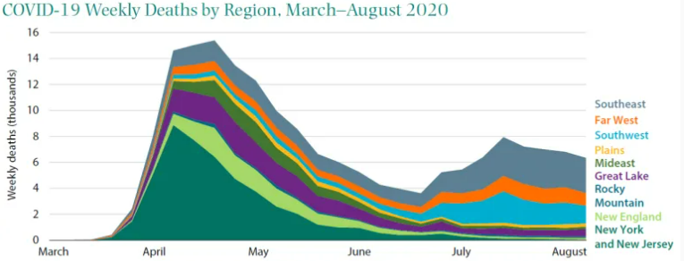
Motivation:
Increased number of disease outbreak
Lack of accurate forecasting
Human distress
Lack of medical preparedness

Slide 3
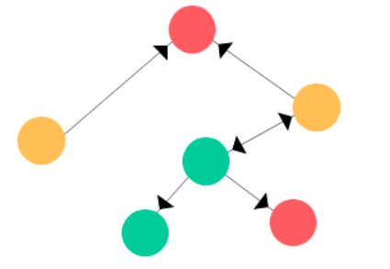
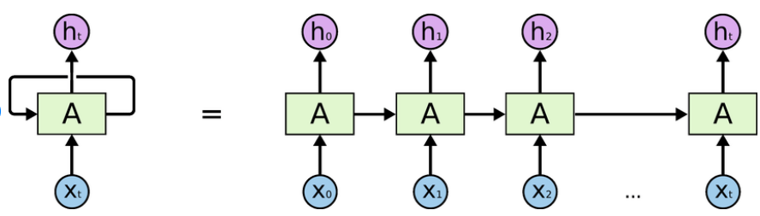
Related Works:
Time series forecasting of COVID-19 transmission in Canada using LSTM networks [1]
John Hopkins COVID-19 Dataset
Demographic and environmental parameters
Data-Driven Time Series Forecasting for Social Studies Using Spatio-Temporal Graph Neural Networks [2]
Considered Nodes as counties where each neighboring nodes is connected to one another
Transfer Graph Neural Networks for Pandemic Forecasting [3]
Considered Nodes as regions and human mobility as edges

Slide 4
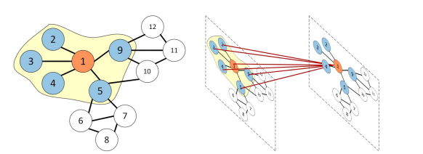

Problem Definition:

Slide 5
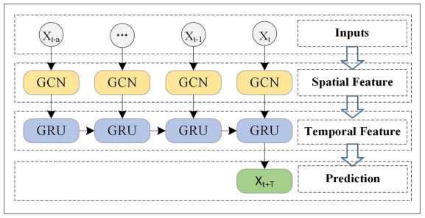
Temporal Graph Convolutional Network:
T-GCN: A Temporal Graph Convolutional Network for Traffic Prediction [4]

Slide 6
Dataset:
Datasets | # Nodes | Sample Rate | # Sample for Time Duration | Time Duration
Italy | 104 | 1 day | 105 | Feb 24 – June 5, 2020
France | 94 | 1 day | 78 | Mar 10 – May 12, 2020

Slide 7
Prediction results of the T-GCN model and other baseline methods:
T | Metric | Italy |  |  | France
 |  | HA | SVR | T-GCN | HA | SVR | T-GCN
3 day | RMSE | 28.71 | 32.51 | 30.59 | 39.86 | 40.66 | 9.85
 | MAE | 18.65 | 18.48 | 19.66 | 21.96 | 22.25 | 7.77
 | Accuracy | 0.283 | 0.188 | 0.236 | 0.086 | 0.067 | -5.70
 | R² | 0.251 | 0.040 | 0.150 | 0.191 | 0.239 | -47.11
 | Var | 0.275 | 0.128 | 0.152 | 0.123 | 0.113 | -42.37
6 day | RMSE | 27.63 | 31.15 | 29.90 | 38.98 | 37.28 | 8.87
 | MAE | 16.49 | 17.61 | 20.38 | 20.88 | 19.51 | 7.31
 | Accuracy | 0.293 | 0.223 | 0.253 | 0.082 | 0.061 | -5.98
 | R² | 0.261 | 0.119 | 0.188 | 0.187 | 0.199 | -49.26
 | Var | 0.294 | 0.175 | 0.190 | 0.112 | 0.096 | -44.10

Slide 8
Future Work:
Implement Grid Search for Hyperparameter tuning
Implement Attention based methods to search for higher accuracy
Implement for US counties dataset
5/4/2022
8

Slide 9
Reference:
Chimmula, V. K. R.; and Zhang, L. 2020. Time Series Forecasting of COVID-19 transmission in Canada Using LSTM Networks. Chaos, Solitons & Fractals 109864.
Li F., Dong B., Khan L., Thuraisingham B., Brandt P. T., D’Orazio V. J., Data-Driven Time Series Forecasting for Social Studies Using Spatio-Temporal Graph Neural Networks. GoodIT ‘21: Proceedings of the Conference on Information Technology for Social Good.
Panagopoulos, George and Nikolentzos, Giannis and Vazirgiannis, Michalis, Transfer Graph Neural Networks for Pandemic Forecasting, Proceedings of the 35th AAAI Conference on Artificial Intelligence, 2021.
Zhao, Ling and Song, Yujiao and Zhang, Chao and Liu, Yu and Wang, Pu and Lin, Tao and Deng, Min and Li, Haifeng, T-GCN: A Temporal Graph Convolutional Network for Traffic Prediction, IEEE Transactions on Intelligent Transportation Systems, 2019
5/4/2022
9

Slide 10
Thank you

